Slide 1
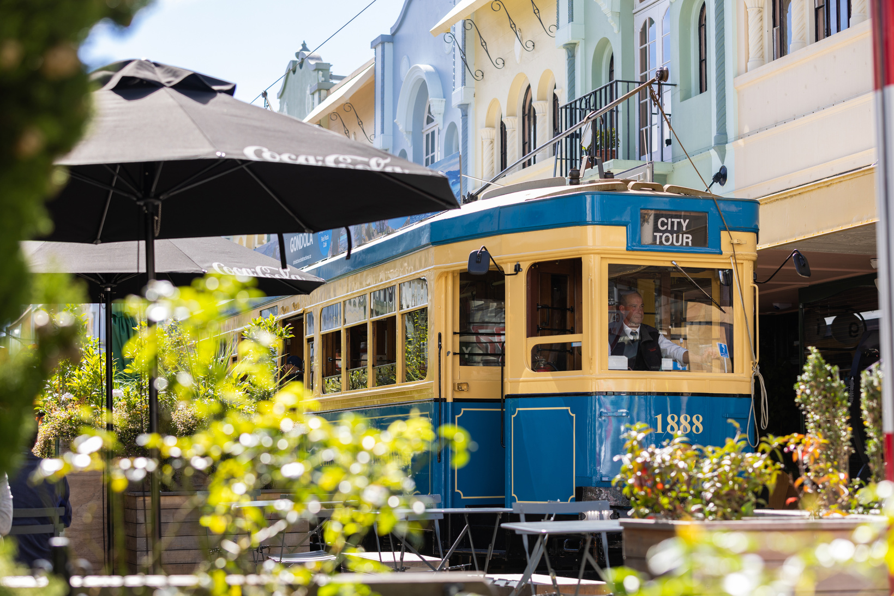


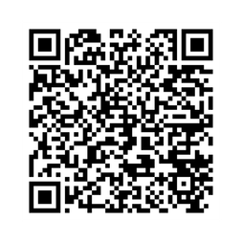




AUSTRALIAN
COMMUNICATION THEORY
WORKSHOP 2026
NAU MAI, HAERE MAI | WELCOME
GUEST WIFI

Slide 2


EMERGENCY
PROCEDURES
EARTHQUAKE
Get underneath tables, stand or crouch against walls, or crouch while protecting your head.
Do not try to walk, crawl if you need to move.
Do not leave the building.
When shaking stops, calmly evacuate the building to nearest evacuation point.
GUEST WIFI

